Slide 1
The Fear-Industrial Complex¹
An analysis on the amount of fear that plays into current US news media by Samuel Kolodrubetz

Slide 2
Table of Contents
Topic Introduction and Importance
Research Questions
Methods of Analysis
Data Sources and Descriptions
Initial Results (Exploratory Analysis)
Machine Learning Models
Expected Outcomes
Resources

Slide 3
Topic Introduction
Fear and controversy have always been big factors in the way news outlets frame stories. Ever since the 19th century, one phrase has been a centerpiece for how stories are told to the public: “if it bleeds it leads”², meaning if a story can scare or intimidate the audience to coming back for more, it will be published.
This project is an attempt to quantify the level of fear (among other emotions) within current news media, particularly online articles, various news outlets use in their daily reporting.

Slide 4
Why is this important?
The news is highly important for average individuals; it allows them to stay up to date with current events and see how it affects their lives.
It is even more important, however, to understand the motivations behind news outlets and the tactics they use to keep viewers coming back to read more.
Understanding how fear is used as a strategy by these outlets is essential in recognizing sensationalized reporting and having the news benefit the viewer rather than viewers falling victim to these tactics.

Slide 5
Research Questions
Is it possible to quantify the amount of fear (and other emotions) in news articles among various news outlets?
Is there a difference in the levels of fear used between these media outlets as well as in the same outlet across several years?

Slide 6
Methods of Analysis
There are two steps I am taking to investigate the questions of this project:
Perform sentiment analysis on a pre-labeled dataset of tweets to train a Recurrent Neural Network (RNN) that will classify the tweets based on their label’s emotion.
Use the RNN created in step 1 on real-world news articles of a particular topic to determine the amount of fear (among other emotions) are used on various news outlets.

Slide 7
Data Source - RNN Training
The data comes from huggingface.co², and contains 416,809 entries with 2 columns:
Text - the (partially) cleaned text of the tweets gathered by the authors of the dataset.
Emotions - the label of the tweet, which is one of 6 emotions: fear, anger sadness, joy, love and surprise.

Slide 8
Data Source - Real News Articles
The real-world articles will come from several news outlets across the political spectrum, specifically:
AP News
CNN
Fox News
To get a clear picture on the amount of fear that a news outlet uses, more articles scraped and used is better. I will attempt to get at least 100 articles from each outlet.

Slide 9
Initial Results - Text Preprocessing
Below is an example (from Huggingface) of a sentence being transformed from the original text into something that can be analyzed with machine learning.
Original sentence - “I was feeling a little low a few days back”
Tokenized - [“I”, “was”, “feeling”, “a”, “little”, “low”, “a”, “few”, “days”, “back”]
No Stopwords - [“feeling”, “little”, “low”, “days”, “back”]
Lemmatized - [“feel”, “little”, “low”, “day”, “back”]

Slide 10
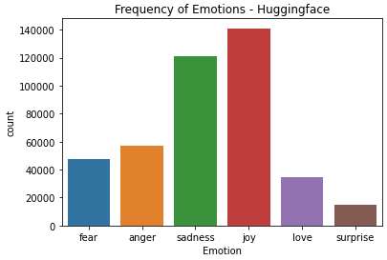
Initial EDA
The above shows we have a class imbalance among the emotion, with joy and sadness having much more samples than other classes. To combat this class analysis I plan to downsample sadness and joy to the levels of fear (around 45,000 samples).

Slide 11
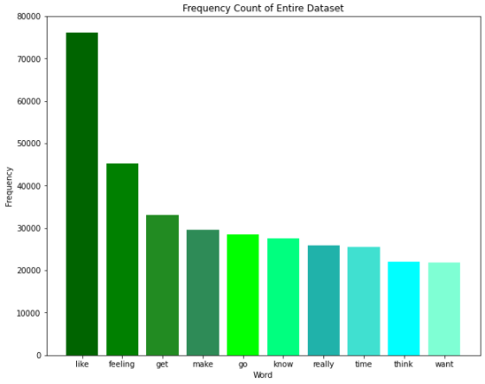
Initial EDA - Word Frequency

Slide 12
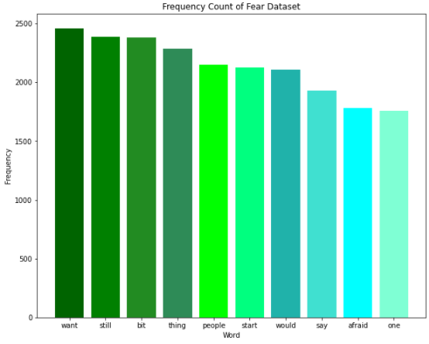
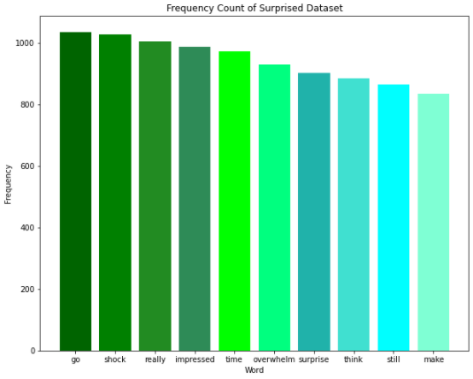
Initial EDA - Word Frequency

Slide 13
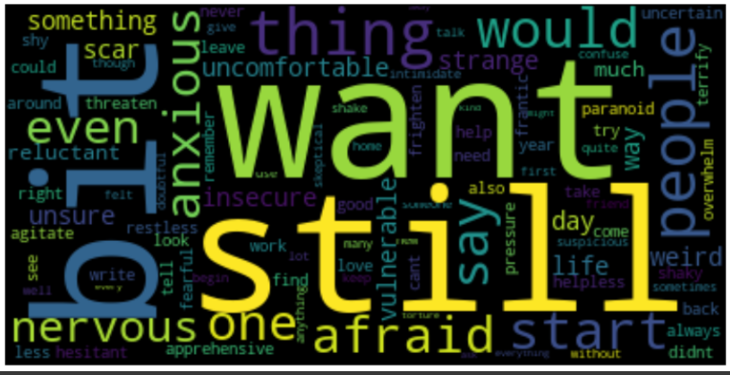
Initial EDA - Word Clouds (Fear)
When looking at the top 100, we can start to see the emotion’s words coming through, much more than the bar chart!

Slide 14
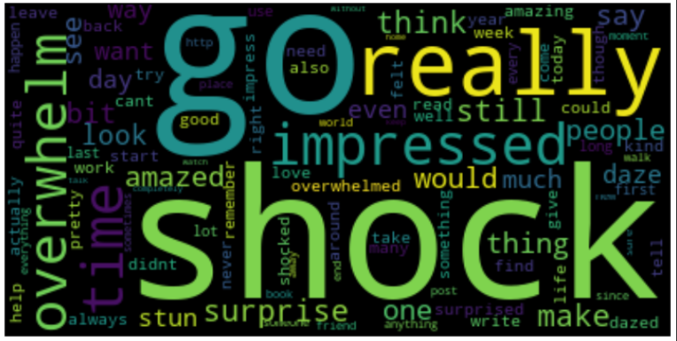
Initial EDA - Word Clouds (Fear)
Surprised is another great emotion that demonstrates the different lexicons being used in tweets with different emotions. Aside from the standard words that are found everywhere, this wordcloud has many “surprised” words.

Slide 15
Machine Learning Implementation
As mentioned before, the best way to tackle text data and sentiment analysis is to use a Recurrent Neural Network (RNN). This is because RNNs allow the model to learn dependencies through time, which is essential when considering the context of words and phrases within the entire document.

Slide 16

ML Implementation - RNN Architecture

Slide 17
Expected Outcomes
As noted in Bouazizi and Ohtsuki’s paper³, multi-class sentiment analysis is hard to get a high accuracy (they got 60.2% accuracy with 7 different classes). I aim to reach an accuracy at least higher than this result on the model created with the Huggingface data.
Similarly, with real-world news I do not expect a completely accurate and successful classification of these articles. However, with articles curated specifically for their content and usage of fearful language, I expect the model to recognize these as fearful.
I expect the more partisan news outlets (CNN and Fox News) to use more fear relative to the “unbiased” reporting of sites like AP News.

Slide 18
References
¹ - https://abcnews.go.com/2020/story?id=2898636&page=1
² - https://www.chicagotribune.com/news/ct-xpm-1989-11-05-8901280504-story.html
³ - https://huggingface.co/datasets/emotion/viewer/default/train
⁴ - https://ieeexplore.ieee.org/stamp/stamp.jsp?arnumber=8681053

